Slide 1
Viz of Region wise Workook
File created on: 1/13/2024 8:51:27 PM

Slide 2
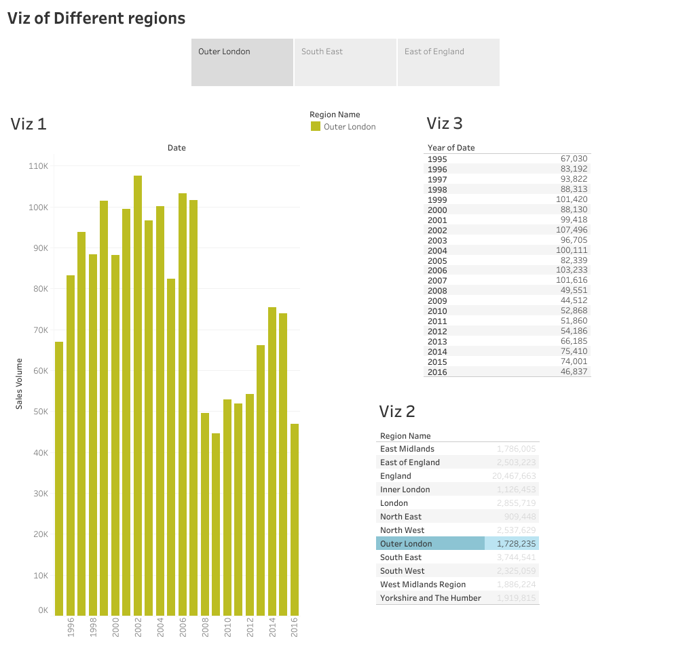

Slide 3
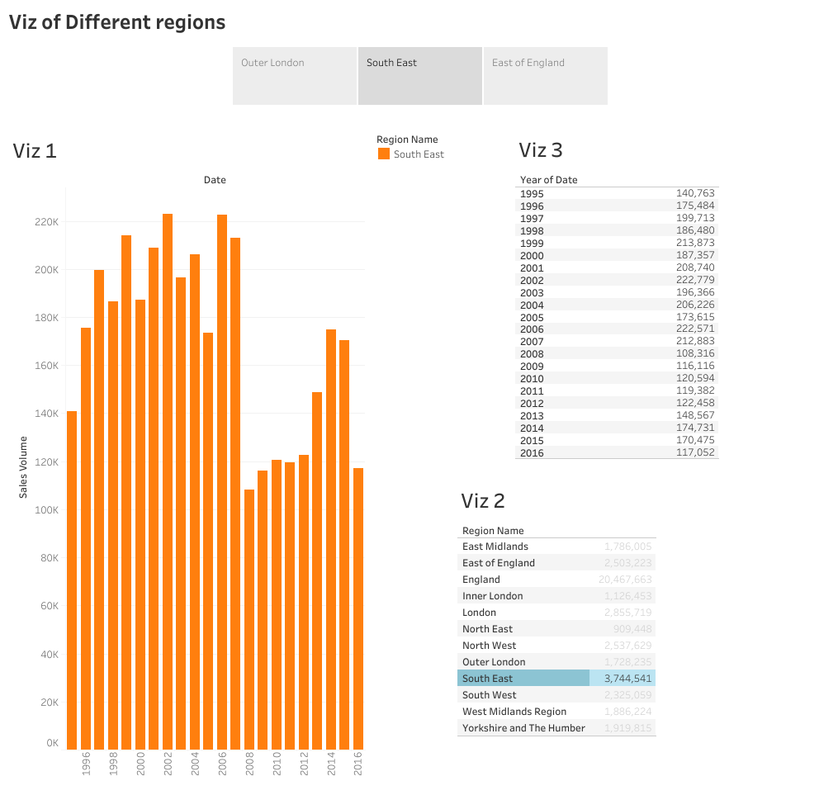

Slide 4
